Slide 1
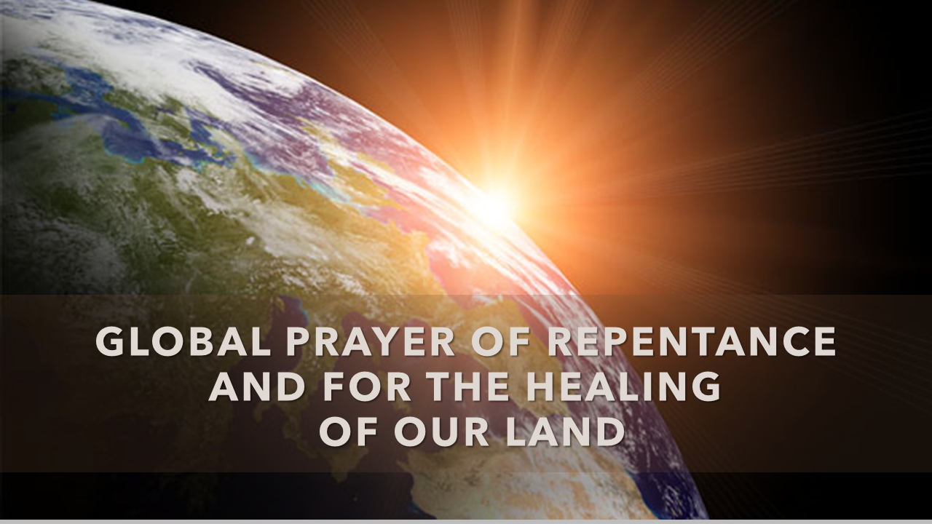
Jan. 31st
&
Feb. 1st

Slide 2
Global Days of Prayer for Repentance and to Heal Our Land
God was not caught off guard by this pandemic or the current cares of His people. He gave us the antidote many years ago knowing that this day would come. Our current situation is not just physical but also emotional, social, and very much spiritual.
The bible states that there is nothing new under the sun. Our Father has prepared the way for healing, repentance, redemption, and restoration. Three key scriptures of the bible speak of humbling ourselves, repenting, seeking, and taking dominion; which brings healing and restoration.

Slide 3
Global Days of Prayer
Family & Friends,
Please place these dates on your calendar, Facebook, Twitter, or any other social media source that you use encouraging family and friends to take a moment to pray:
“A prayer of repentance” on January 31, 2021
“A prayer that God would heal our Land” on February 1, 2021

Slide 4
Global Days of Prayer
We understand that people may be at work or otherwise engaged, but on those days someone, somewhere will be praying, or closing their eyes in silence to hear from heaven the same time that you are.
Whenever you have 5 minutes on January 31, 2021, please let us humble ourselves and repent before our Heavenly Father.
Whenever you have 5 minutes on February 1, 2021, please take the time to speak to our Heavenly Father to heal our Land.

Slide 5
2 Chronicles 7:14
⁷ If my people who are called by my name humble themselves, and pray and seek my face and turn from their wicked ways, then I will hear from heaven and will forgive their sin and heal their land.

Slide 6
Genesis1:26-28
²⁶ Then God said, “Let us make man in our image, after our likeness. And let them have dominion over the fish of the sea and over the birds of the heavens and over the livestock and over all the earth and over every creeping thing that creeps on the earth.” ²⁷ So God created man in his own image, in the image of God he created him; male and female he created them. ²⁸ And God blessed them. And God said to them, “Be fruitful and multiply and fill the earth and subdue it, and have dominion over the fish of the sea and over the birds of the heavens and over every living thing that moves on the earth.”

Slide 7
Jeremiah 31:10-13
¹⁰ “Hear the word of the Lord, O nations, and declare it in the coastlands far away; say, ‘He who scattered Israel will gather him, and will keep him as a shepherd keeps his flock.’ ¹¹ For the Lord has ransomed Jacob and has redeemed him from hands too strong for him. ¹² They shall come and sing aloud on the height of Zion, and they shall be radiant over the goodness of the Lord, over the grain, the wine, and the oil, and over the young of the flock and the herd; their life shall be like a watered garden, and they shall languish no more. ¹³ Then shall the young women rejoice in the dance, and the young men and the old shall be merry. I will turn their mourning into joy; I will comfort them, and give them gladness for sorrow.

Slide 8
Humility
As we humble ourselves before him. He will meet us there, for He is a good Father and our closest friend. Let us join together locally, nationally and globally in prayer that He would come and heal our Land.

Slide 9
Sample Prayers
PRAYER OF REPENTANCE
Father we humbly come asking for forgiveness. We acknowledge that we have sinned, whether it was intentional or non intentional. We ask for forgiveness. Lord forgive any thoughts or deeds that have grieved Your spirit or any thing that has exalted itself against Your will and Your way. Have mercy on us Lord according to Your unfailing love. Create in us a pure heart and renew a steadfast spirit within us. In Jesus’ name we pray. Amen
PRAYER OF HEALING FOR OUR LAND
Oh God we pray to You. We Humble ourselves again. Lord, hear our cry. We ask that You Heal our land. That every eye will see, that every heart will know the One who took our sins, the One who died and rose. For we know Your desire is to heal what's broken and mend what is shattered. In Jesus’ name we pray. Amen

